Slide 1
Gamma thoughts

Slide 2
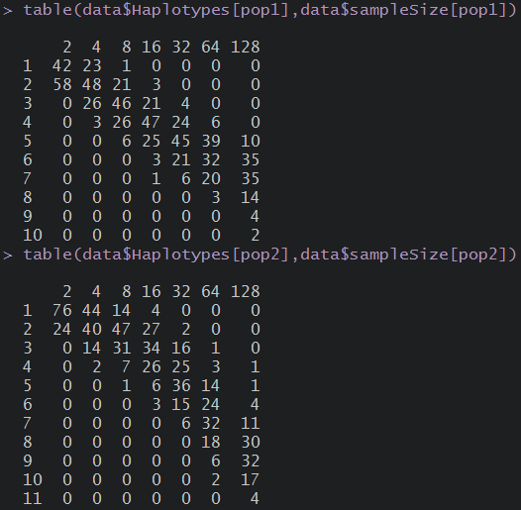
Distribution of number of haplotypes in the simulated samples
Population 1
Theta=2
Growth
Population 2
Theta=2
No Growth

Slide 3
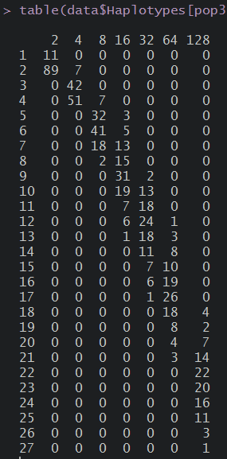
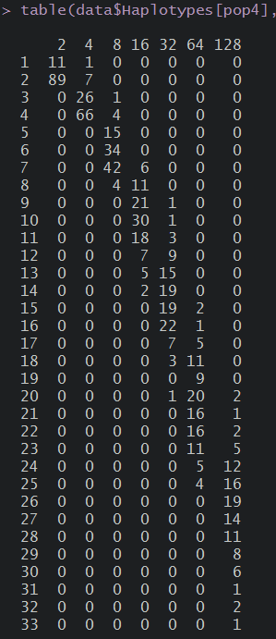
Population 3: Theta=10 Growth
Population 4: Theta=10 No Growth

Slide 6
Population 1

Slide 7
Population 2

Slide 8
Population 3

Slide 9
Population 4

Slide 10
Trying kernels

Slide 11
Here without specifying bandwith

Slide 12
Here I tried to put the haplotype diversity as the band width

Slide 13
Theta and segregating sites
Here some plots to help thinking in the Wakeley method

Slide 14
Distribution of segregating sites

Slide 15
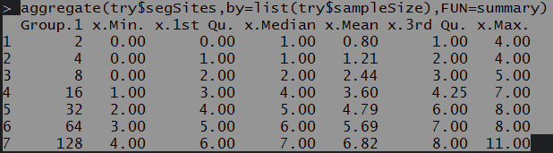
Population 1 (T2g)

Slide 19
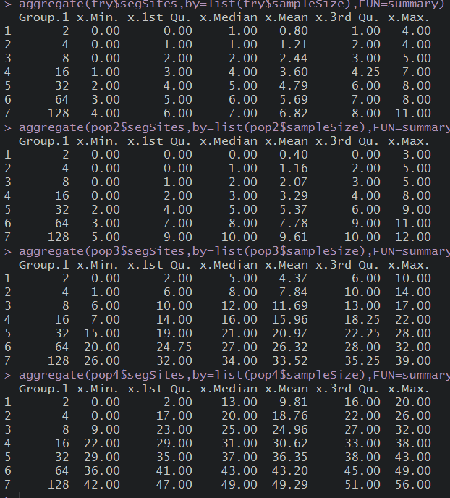

Slide 20
segSites vs best.n.values
Number of segregating sites

Slide 21
Empirical distributions
Here plots on the empirical distributions of observed values

Slide 22
Violin plots of simulated data
Population 1- theta 2
Population 3- theta 10
n128
n128
n64
n64
n32
n32
n16
n16
n8
n8
n4
n4
n2
n2
2
4
6
8
10
0
5
10
15
20
25
Observed number of haplotypes

Slide 23
Population 1-theta 2
Population 3-theta 10
Observed haplotypes
10
Observed haplotypes
25
8
20
6
15
4
10
2
5
0
n2
n4
n8
n16
n32
n64
n128
n2
n4
n8
n16
n32
n64
n128

Slide 24
SAMPLING THEORY
Ewens 1972

Slide 25
Expected number of haplotypes
Variance in the number of haplotypes
40
theta=20
theta=10
theta=2
theta=20
theta=10
theta=2
20
30
15
expHap.t20
varHap.t20
20
10
10
5
0
20
40
60
80
100
120
0
20
40
60
80
100
120
n
n

Slide 30
Sampling theory data using Ewens formula

Slide 31
Theta and segregating sites
Here some plots with the new Wakeley data and thinking about bias

Slide 32
Merge for only the mode of the segregating sites for each combination

Slide 33
Merge for all segregating sites

Slide 34
Histogram of segsites$n.seg.sites[which(segsites$Theta == "ten" & segsites$samplingSize == 32)]
30
25
20
15
Frequency
10
5
0
30
32
34
36
38
40
42
segsites$n.seg.sites[which(segsites$Theta == "ten" & segsites$samplingSize == 32)]
In red I put the first and third quantiles of the distribution of segregating sites. So maybe what we should do is match only those segregating sites with Wakeley’s data….

Slide 36
I decided to get the .95 and 0.05 (red lines) instead of the 0.75 and 0.25 (blue lines)

